Slide 1
Advanced Java

Slide 2
What is XML ?
XML (eXtensible Markup Language) is just a structured way to store and transport data.
XML is a markup language much like HTML
Example:
<user> <id>1</id> <name>John</name> </user>

Slide 3
XML Does Not Use Predefined Tags
The XML language has no predefined tags.
HTML works with predefined tags like <p>, <h1>, <table>, etc.
With XML, the author must define both the tags and the document structure.

Slide 4
Key Features of XML
Self-descriptive → You can understand the data just by looking at it
Custom tags → You create your own tags (unlike HTML)
Platform-independent → Works everywhere (apps, web, databases)
Hierarchical structure → Like a tree (parent → child)

Slide 5
Rules of XML
Every tag must have a closing tag
Tags are case-sensitive
Must have one root element
Proper nesting

Slide 6
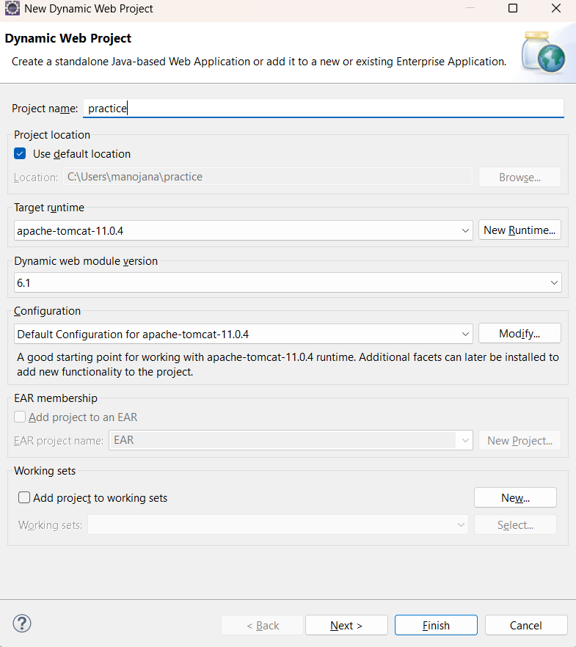
How to create new Project
In eclipse IDE
File→new→Dynamic web project→
project name

Slide 7
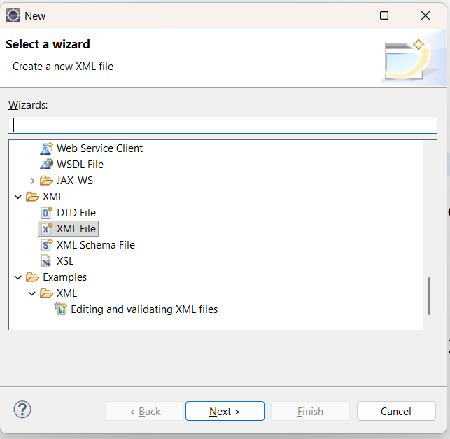
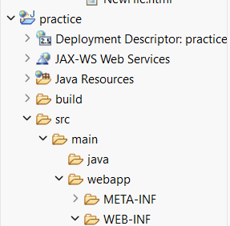
Then to create your first XML file in that project..
To right click in Webapp →to create new →others→xml file

Slide 8
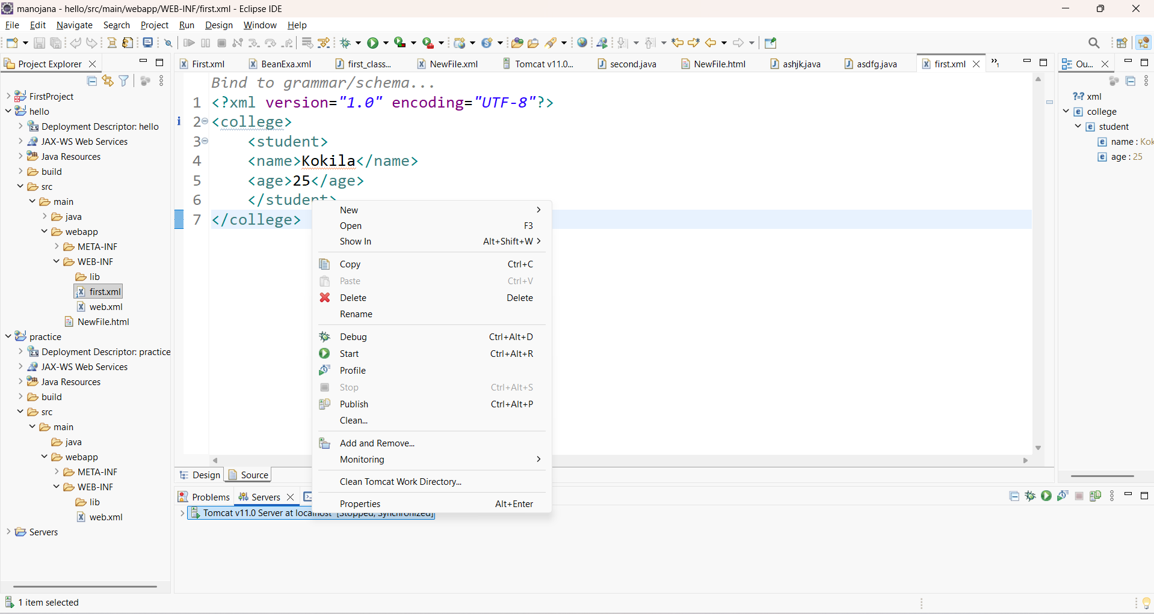
First XML code and To start the server

Slide 9
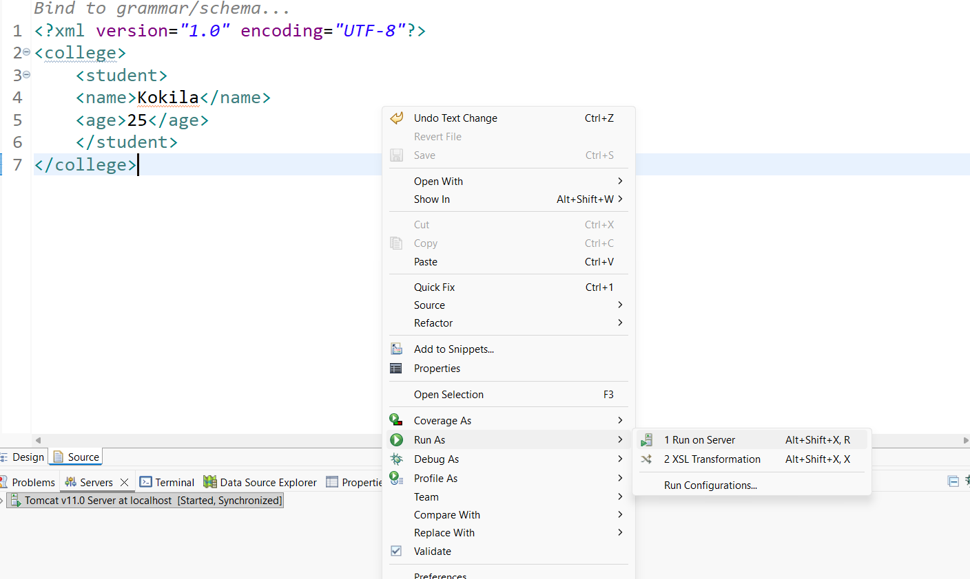
After start the server, to run the XML file

Slide 10
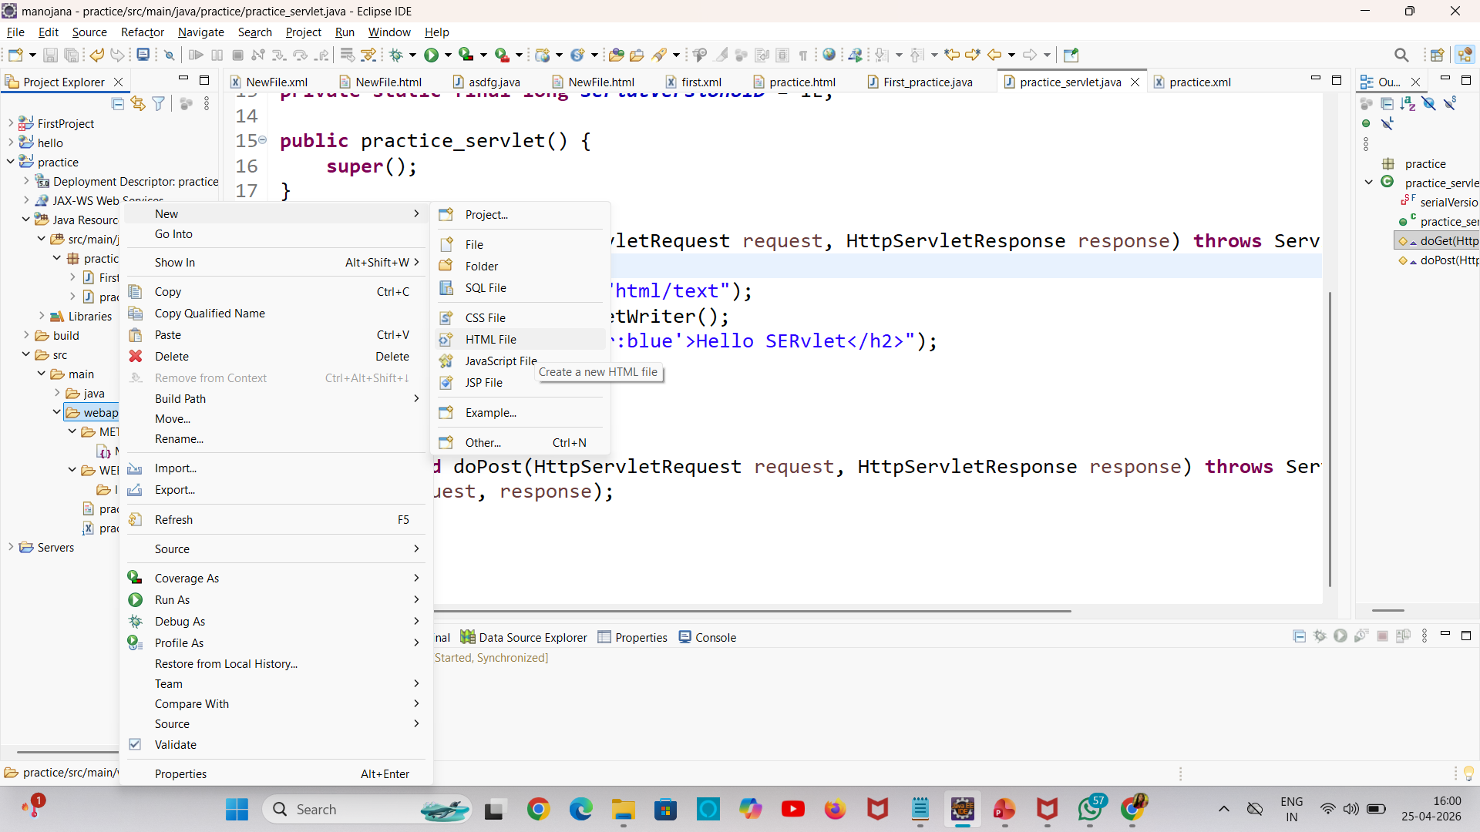
To create html file also

Slide 11
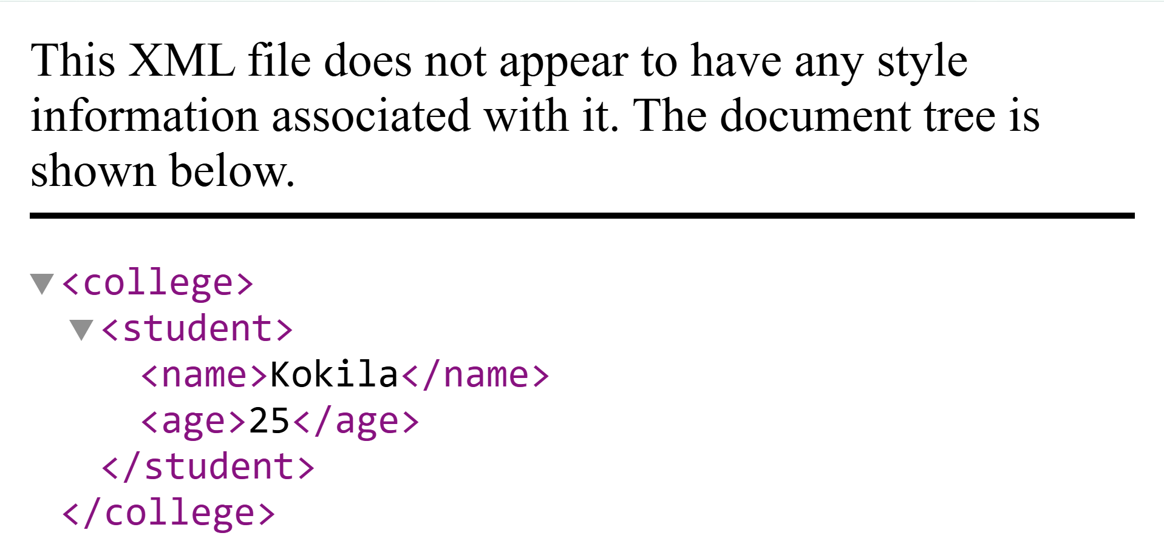
The XML output is..

Slide 12
What is a DOM Parser?
A DOM Parser (Document Object Model Parser) is a tool that:
Reads XML (or HTML)
Converts it into a tree structure in memory
Lets you access and modify data easily

Slide 13
The DOM parser in HTML
To create HTML file is
Projectname→right click→src→Webapp→rightclick→html file

Slide 14
Example HTML code
<h1 id="demo"></h1>
<script>
var z, Doct,text;
z=new DOMParser();//
text="<college><student>"+
"<name>Anup</name>"+"<email>anupgmail.com</email>"+"</student>"+
"<student>"+
"<name>kokila</name>"+"<email>abc@gmail.com</email>"+"</student></college>";
Doct=z.parseFromString(text, "text/xml");
document.getElementById("demo").innerHTML=
Doct.getElementsByTagName("name")[1].childNodes[0].nodeValue;
</script>

Slide 15
How to create java file
Project→doubleclick→java resources→doubleclick→src/main/java
rightclick→new→package→give package name→finish
Packagename→rightclick→new→class→class name,main function→
Finish.

Slide 16
XML DTDs
DTD specifies the legal building blocks of XML. It defines elements, attributes, and their relationships, ensuring the XML document follows a valid structure.
It tells:
Which elements are allowed
The order of elements
What data they contain

Slide 17
Normal code
<student>
<name>Kokila</name>
<age>25</age>
</student>
DTD for this code
<!DOCTYPE student [
<!ELEMENT student (name, age)>
<!ELEMENT name (#PCDATA)> <!ELEMENT age (#PCDATA)> ]>
<student>
<name>Kokila</name>
<age>25</age>
</student>

Slide 18
Explanation
<!DOCTYPE student> → root element
<!ELEMENT student (name, age)>
student must contain name and age
#PCDATA → Parsed Character Data (text)

Slide 19
XML Schema (XSD)
XML Schema (XSD) is used to define the structure and data types of an XML document.
It is more powerful than DTD because it can validate:
Elements
Attributes
Data types (int, string, date, etc.)

Slide 20
Example:
<?xml version="1.0" encoding="UTF-8"?>
<xs:element name="college">
<xs:student>
<xs:element name="name" type="xs:string"/>
<xs:element name="email" type="xs:string"/>
</xs:student>
</xs:element>

Slide 21
Web Applications
A web application is a client-server based application that runs on a web server and is accessed through a browser.
It consists of frontend, backend, and database components.
Examples we already use:
Gmail
Facebook
Amazon

Slide 22
How a Web Application Works
User opens browser (Chrome, Edge, etc.)
Sends request to server
Server processes request
Server sends response (HTML page)
Browser displays output
This is called Client–Server Architecture

Slide 23
For Example:
Login to a website:
You enter username/password
Data goes to server
Server checks database
Sends success/failure

Slide 24
Features of Web Applications
Accessible anywhere (internet required)
No installation needed
Platform independent
Easy to update
Disadvantages
Needs internet
Security risks
Can be slower than desktop app

Slide 25
HTTP
HTTP stands for HyperText Transfer Protocol.
HTTP is a protocol used to transfer web pages and data between a client and a server over the internet.
It is a communication protocol used to transfer data between:
Client (browser)
Server (web server)

Slide 26
How HTTP Works
You open a website in browser
Browser sends an HTTP Request
Server processes it
Server sends an HTTP Response
Browser displays the page

Slide 27
HTTP Request
Sent by client (browser)
Contains:
Method (GET, POST, etc.)
URL
Headers
Body (optional)
Method | Purpose
GET | Get data
POST | Send data
PUT | Update data
DELETE | Delete data

Slide 28
HTTP Response
Sent by server
Contains:
Status code
Headers
Data (HTML, JSON, etc.)
Code | Meaning
200 | OK
404 | Not Found
500 | Server Error

Slide 29
Features of HTTP
Stateless → each request is independent
Simple → easy to use
Fast communication
HTTP vs HTTPS
HTTP | HTTPS
Not secure | Secure
No encryption | Uses encryption
Uses port 80 | Uses port 443

Slide 30
Servlet
A Servlet is a Java program that runs on a web server and handles client requests and responses.
It is mainly used to create dynamic web applications.
Servlet Architecture (Flow)
Browser → Web Server → Servlet → Database
← ←
Response sent back

Slide 31
How Servlet Works
Servlet follows the same HTTP request–response cycle:
Client (browser) sends request
Web server receives request
Servlet processes it
Servlet sends response
Browser displays result

Slide 32
Servlet Life Cycle
1. init()
Called once when servlet is loaded
Used for initialization
2. service()
Called for every request (doGet()→Handle GET request
doPost()→Handle POST request)
Processes request and sends response
3. destroy()
Called when servlet is removed
Used for cleanup

Slide 33
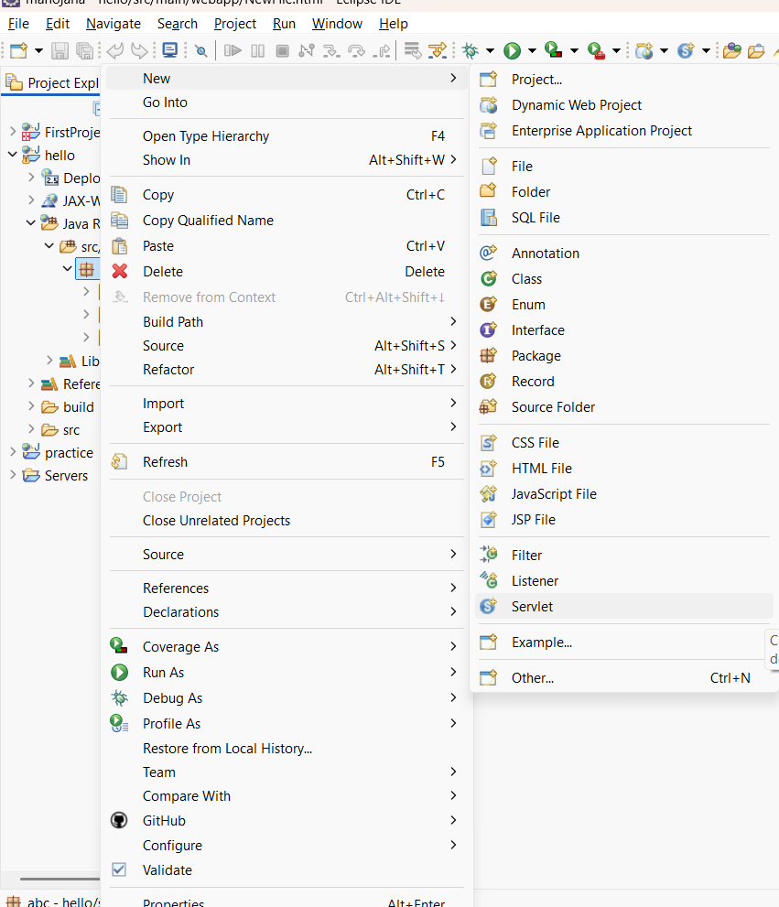
How to create servlet file in eclipse
Project→double click→Java resources→packagename→right click→
New→servlet file.

Slide 34
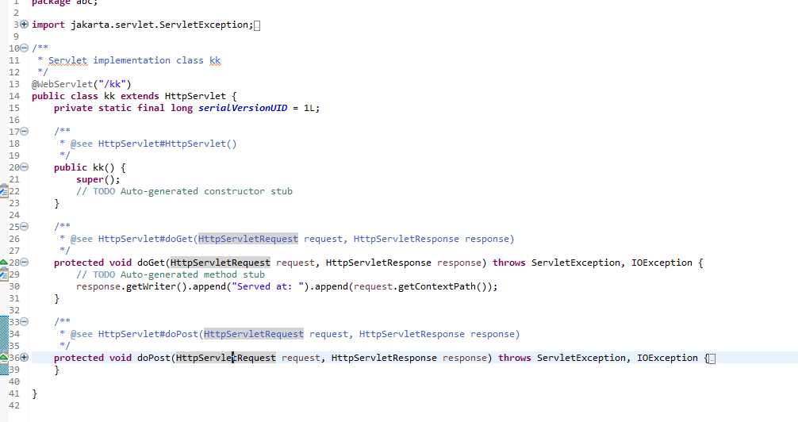
To give servlet file name

Slide 35
To write this code
protected void doGet(HttpServletRequest request, HttpServletResponse response) throws ServletException, IOException {
response.setContentType("text/html");
PrintWriter out = response.getWriter();
out.println("<h1>Hello Kokila!</h1>");
}
Output is in h1 format
Hello Kokila

Slide 36
Why this output?
Inside your doGet():
PrintWriter out = response.getWriter(); out.println("<h1>Hello Kokila!</h1>");
setContentType("text/html") → tells browser it's HTML
<h1> → displays big heading
So browser renders it as a webpage

Slide 37
Servlet Request and Response
1. Servlet Request
The request represents the data sent by the client to the server.
In Java Servlets, this is handled using the HttpServletRequest interface.
Common methods:
getParameter("name") → gets form data
getParameterValues() → multiple values (checkboxes)
getHeader("User-Agent") → browser info
getSession() → access session

Slide 38
Simple Servlet Example
To create servlet file→in that file
protected void doGet() function to write this code
String name = request.getParameter("name");
response.setContentType("text/html");
PrintWriter out = response.getWriter();
out.println("<h2>Welcome " + name + "</h2>");
In this code we want to request to name ,and response from HTML file

Slide 39
2. Servlet Response
The response is what the server sends back to the client.
Handled using the HttpServletResponse interface.
Sends output (HTML, JSON, etc.) to the client
Common methods:
getWriter() → sends text response
setContentType("text/html") → sets MIME type
sendRedirect("url") → redirects client
setStatus(200) → HTTP status

Slide 40
To create html file to send name for previous code
<form action="req_res_servlet" method="post">
Enter Name: <input type="text" name="name">
<input type="submit" value="Submit">
In action we must give already created our servlet file name like
req_res_servlet

Slide 41
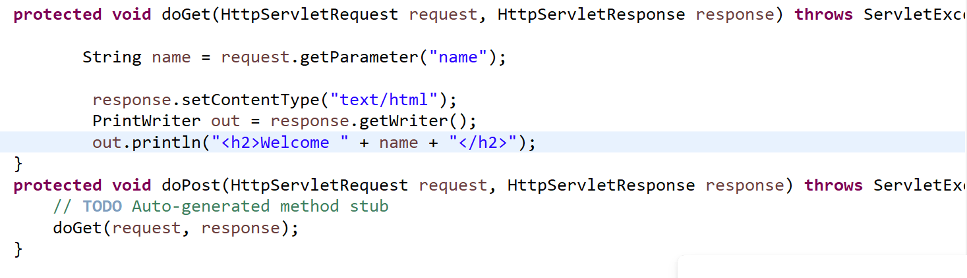
The input is
req_res_servlet file

Slide 42
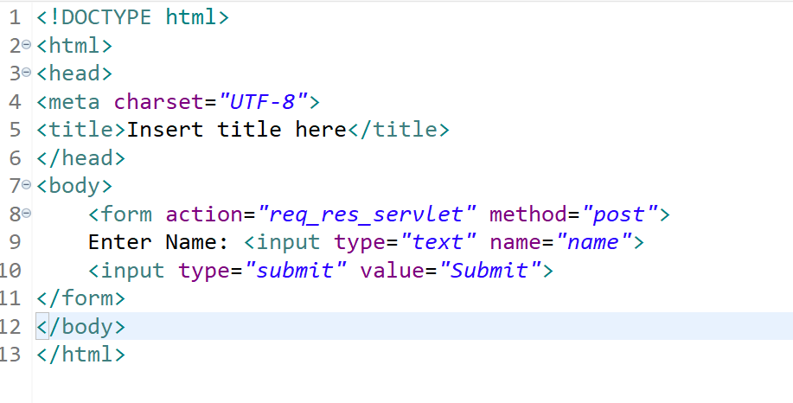
req_res html file

Slide 43


The output is..

Slide 44
Exception Handling
4 keywords used here
try
catch
throws
throw
Same as Java

Slide 45
In doGet() function
response.setContentType("text/html");
PrintWriter out = response.getWriter();
try {
int a = 10;
int b = 0;
int result = a / b; // Exception occurs here
out.println("<h2>Result = " + result + "</h2>");
} catch (ArithmeticException e) {
out.println("<h2>Error: Cannot divide by zero!</h2>");
}
out.println("<h3>Program continues...</h3>");
}

Slide 46
Session Handling
Session handling is used to store user data across multiple requests.
Because HTTP is stateless, the server does not remember the user.
So we use sessions to store data like:
username
login status
user preferences

Slide 47
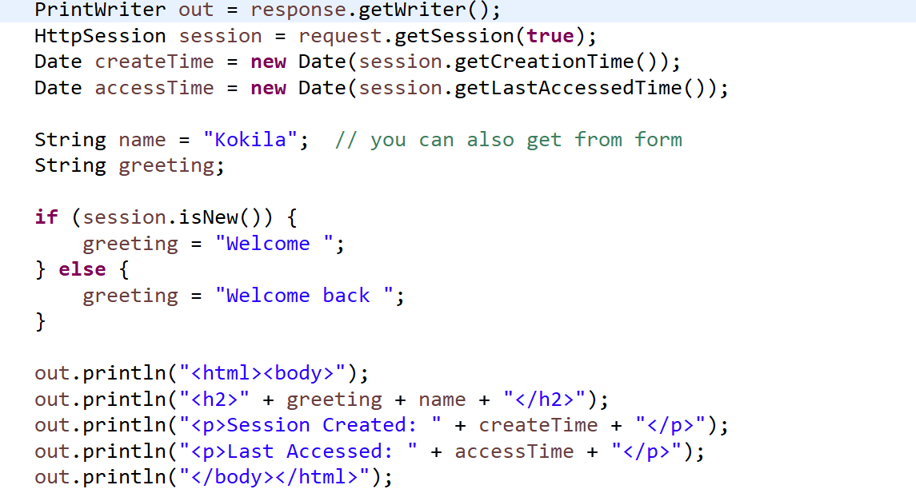
Example

Slide 48
Page Redirection
Page redirection means sending the user from one page/servlet to another page automatically.
import java.io.*;
import javax.servlet.*;
import javax.servlet.http.*;
public class RedirectServlet extends HttpServlet {
public void doGet(HttpServletRequest request, HttpServletResponse response)
throws ServletException, IOException {
response.sendRedirect("welcome.html");
}
}

Slide 49
Auto Refresh
Auto refresh means automatically reloading a page after a fixed time interval.
Example:
response.setIntHeader("Refresh", 10);
response.setContentType("text/html");
Format z=new SimpleDateFormat("dd.MM.yyyy.HH.mm.ss");
Date d=new Date();
String newDate=z.format(d);
PrintWriter out=response.getWriter();
out.print(newDate);

Slide 50
JSP
JSP (JavaServer Pages) is a server-side technology used to create dynamic web pages using Java.
Advantages of JSP
Easy to develop
Less code
Good for UI design
Automatic compilation
Supports reusable components

Slide 51
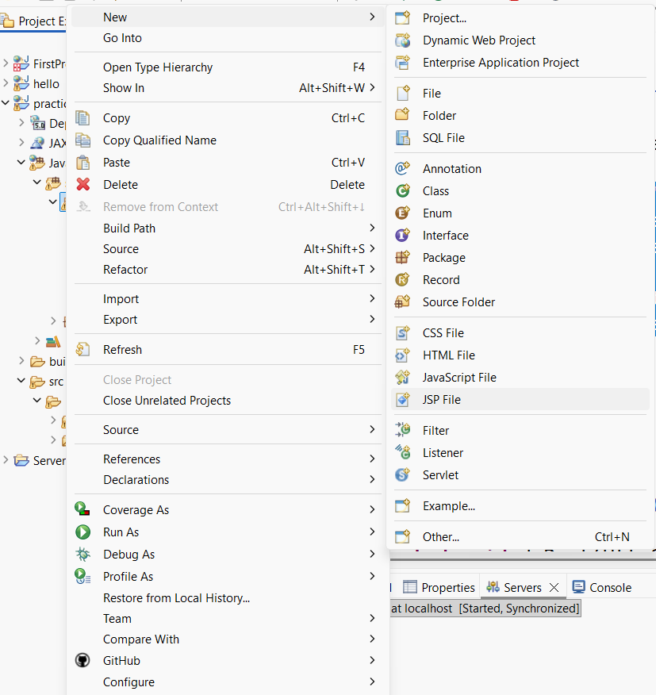
How to create JSP file
Packagename →right click→new→JSP file

Slide 52
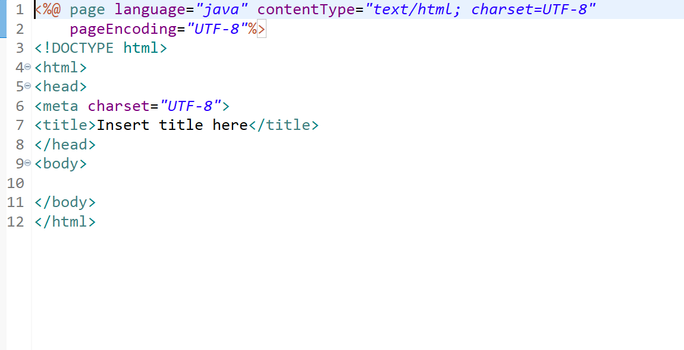
JSP file looks for

Slide 53
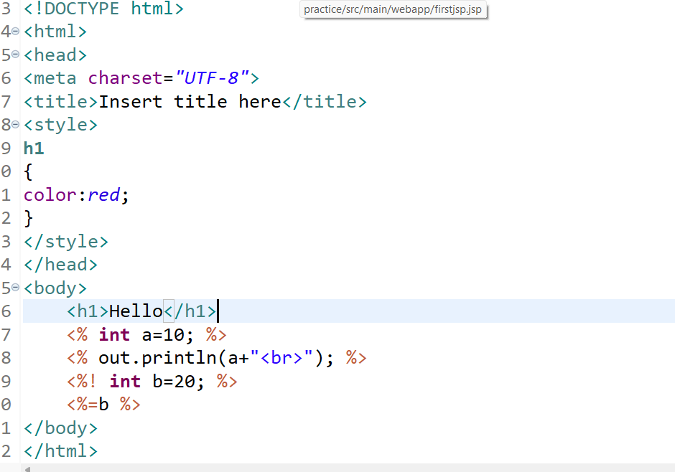
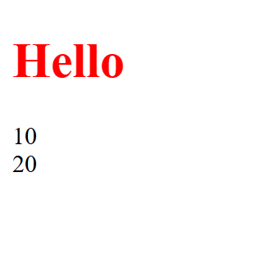
Example JSP and output

